Slide 1
CSE 12 – Basic Data Structures and Object-Oriented Design Lecture 5
Greg Miranda & Paul Cao, Winter 2021
This lecture is being recorded

Slide 2
Announcements
Check course schedule for due times this week
Topic
Linked List implementations

Slide 3
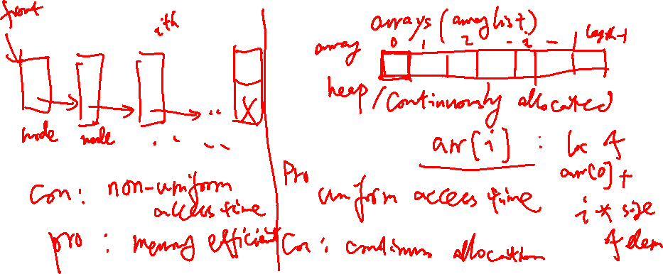
So what is a Linked List?
A Linked List is a data structure that implements a List ADT, where elements in the list may appear anywhere in memory, but are "linked" together in a particular order using references or pointers.
Notes:
Draw out the difference between Array and LinkedList

Slide 4

Memory Model Diagrams and LinkedLists
class Node {
String value;
Node next;
public Node(String value, Node next) {
this.value = value;
this.next = next;
}
}
// Somewhere else in the code… still inside Node class (can access next)
Node n1 = new Node(“paul”, null);
Node n2 = new Node(“greg”, null);
n2.next = n1;
Draw the memory model diagram for this code. Answer choices next slide.

Slide 5

Node n1 = new Node(“paul”, null);
Node n2 = new Node(“greg”, null);
n2.next = n1;
A
data
“paul”
data
“greg”
n1
n2
next
next
null
“greg”
“paul”
B
data
data
n1
n2
next
next
null
C
data
“paul”
data
“greg”
n1
n2
next
next
null
“paul”
“greg”
E. None of these
D
data
data
n2
n1
next
next
null
Notes:
B

Slide 6
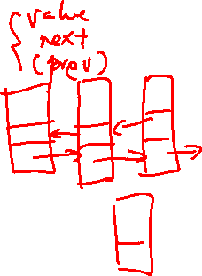
Toward Linked List Implementation
Linked Lists are implemented with a Node class.
The Node forms the structure of the list. It contains:
A reference to the data stored at that position in the list
A reference to the next node in the list
Optionally (for a doubly linked list) a reference to the previous node in the list.
The Linked List itself usually contains only a reference to the first node in the list (head), and sometimes a reference to the last node (tail). It also might store the list’s size.

Slide 7

Singly Linked List with sentinel Node: Picture
Dummy (sentinel) head node
LinkedStringList
object
front
Node
object
Node
object
Node
object
size
next
next
next
null
2
value
null
value
value
String Objects:

Slide 8

Singly Linked List with sentinel Node: Picture
Dummy (sentinel) head node
LinkedStringList
object
front
Node
object
Node
object
Node
object
size
next
next
next
null
2
value
null
value
value
What type is head in the LinkedStringList class?
Node
String
LinkedStringList
StringList
More than one is correct
String Objects:
Notes:
A

Slide 9
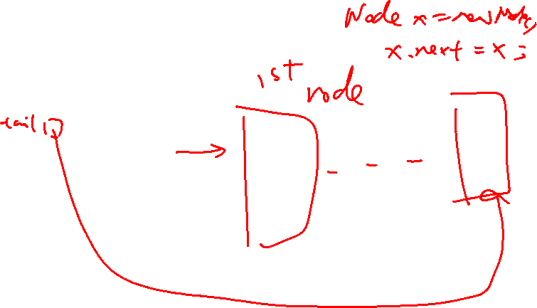
Empty Singly Linked List with sentinel node
MySingleLinkedList
object
head
Node
object
size
next
null
0
data
null
This node is always there!!

Slide 10
Singly Linked List with sentinel Node: Picture
Dummy (sentinel) head node
LinkedStringList
object
front
Node
object
Node
object
Node
object
size
next
next
next
null
2
value
null
value
value
Can you implement a linked list without this dummy (sentinel) node?
Yes
No
String Objects:
Notes:
A

Slide 11
Singly Linked List without sentinel Node: Picture
LinkedStringList
object
front
Node
object
Node
object
size
next
next
null
2
value
value
String Objects:

Slide 12
Empty Single Linked List without sentinel node
LinkedStringList
object
front
size
0

Slide 13
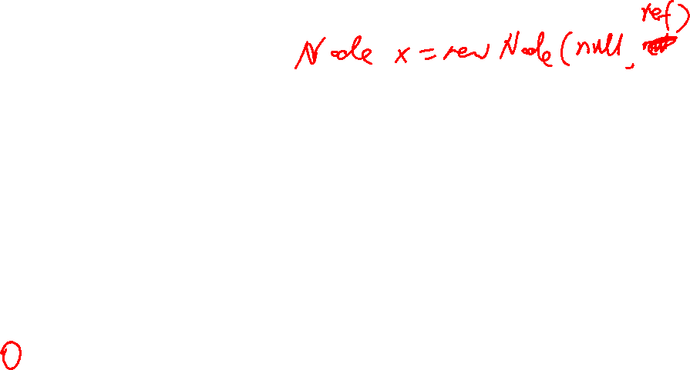
Singly Linked List: Abstracted Picture
front
null
value
value
Does this list use a sentinel node?
Yes
No
Not sure

Slide 14
myL.insert(1, itm)
front
NULL
NULL
// In LinkedStringList class (NOT Node class)
public void insert(int index, String s) {
}
class Node {
String value;
Node next;
public Node(String value, Node next) {
this.value = value;
this.next = next;
}
}

Slide 15
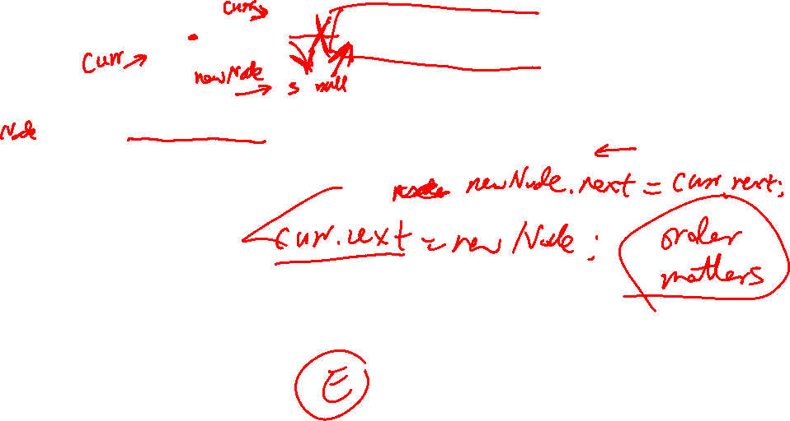
front
myL.add(1, itm)
NULL
NULL
public void insert(int index, String s) {
newNode = new Node(s, null);
if (index<0 || index>size) throw new IndexOutOfBoundsException();
Node curr = this.front;
for(int i = 0; i < index; i++) {
curr = curr.next;
}
______________________________________
this.size += 1;
}
What line of code will complete this method correctly (in the blank)?
A) No line is needed. The code is correct as written.
B) curr.next = newNode;
C) curr = newNode;
D) newNode.next = curr.next;
E) None of them is correct
class Node {
String value;
Node next;
public Node(String value, Node next) {
this.value = value;
this.next = next;
}}

Slide 16

front
myL.add(itm)
NULL
NULL
public void add(String s) {
Node curr = this.front;
while(______A______!= null) {
curr = curr.next;
}
_______________B___________________
this.size += 1;
}
What line of code will complete this method correctly for blank A?
A) curr.next
B) curr
C) front
D) front.next
E) None of them is correct
class Node {
String value;
Node next;
public Node(String value, Node next) {
this.value = value;
this.next = next;
}}

Slide 17
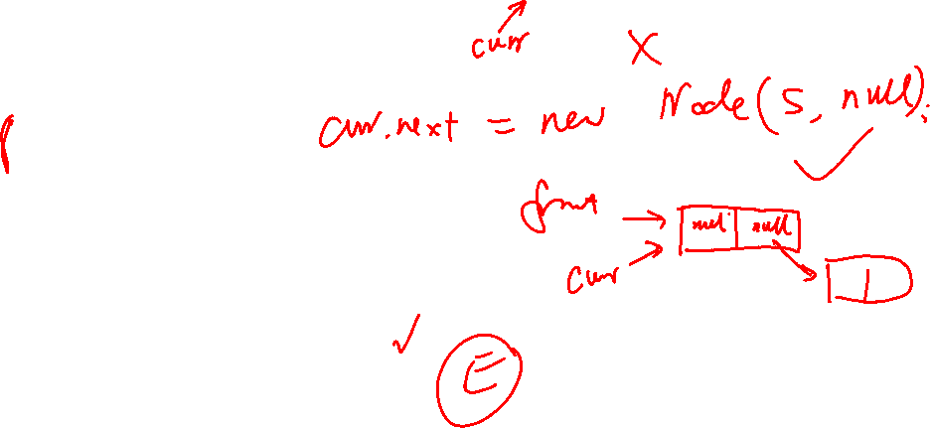
front
myL.add(itm)
NULL
NULL
public void add(String s) {
Node curr = this.front;
while(curr.next != null) {
curr = curr.next;
}
________________B__________________
this.size += 1;
}
What line of code will complete this method correctly for blank B?
A) No line is needed. The code is correct as written.
B) curr.next = new Node(s, curr.next);
C) curr = new Node(s, null);
D) curr.next = new Node(s, curr);
E) None of them is correct
class Node {
String value;
Node next;
public Node(String value, Node next) {
this.value = value;
this.next = next;
}}

Slide 18
LinkedStringList Remove
/* Remove the element at the specified index */
void remove(int index);
Write a test case for the LinkedStringList remove method

